Slide 1

Quiz Application

Slide 2
Content:
1. INTRODUCTION
2. OBJECTIVE
3. SCOPE
4. TOOLS & TECHNOLOGIES
5. USE CASE & ER DIAGRAM
6. CONCLUSION

Slide 3
Intoduction
Good morning, everyone!
I hope you're all doing well. Thank you for joining me in this presentation. My name is […..], and I am excited to introduce you to a revolutionary learning tool – Quiz App.
A very popular and effective way to engage users, access knowledge, and facilitate learning in the today's world is through quizzes.
So, imagine a world where education becomes engaging, interactive, and fun. A world where learning is not confined to textbooks and lectures but takes on an exciting and gamified form. That's precisely what Quiz App is all about.

Slide 4
OBJECTIVE
Engage & Entertain Users
Provide Enhances learning experiences for students of all ages.
Provide educational value
Track & analyze user performance

Slide 5
SCOPE
Target Audience:
Quiz App is designed for students of all ages, from primary school to higher education.
Continuous Updates and Expansion:
Quiz App is regularly updated with new quizzes, content, and features to ensure a fresh and dynamic learning experience.
Collaboration and Social Features:
Users can share their quiz results, achievements, and progress on social media platforms.

Slide 6
Tools & Technology Used:
HTML: For creating the structure and markup of the web pages.
CSS: To style and visually design the quiz application.
JavaScript: For implementing interactivity, user input validation, and dynamic behavior.
PHP: For making dynamic and interactive web page.
Databases: MySQL for storing quiz questions, user data, and many other features related quiz application.
WEB SERVER: Xammp and Github for storing project.

Slide 7
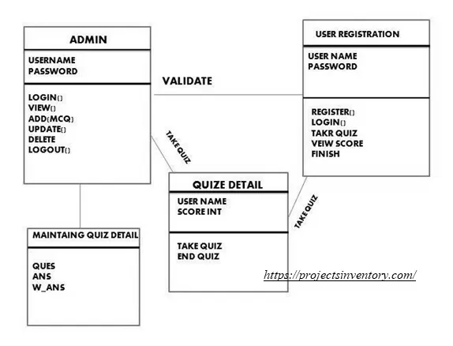
Class Diagram of QUIZ APPLICATION

Slide 8
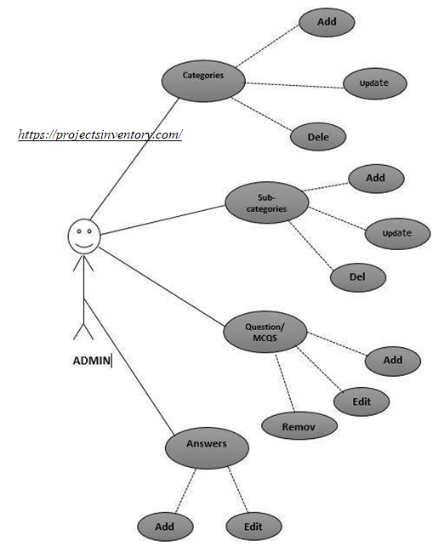
Use case diagram of QUIZ APPLICATION PROJECT

Slide 9
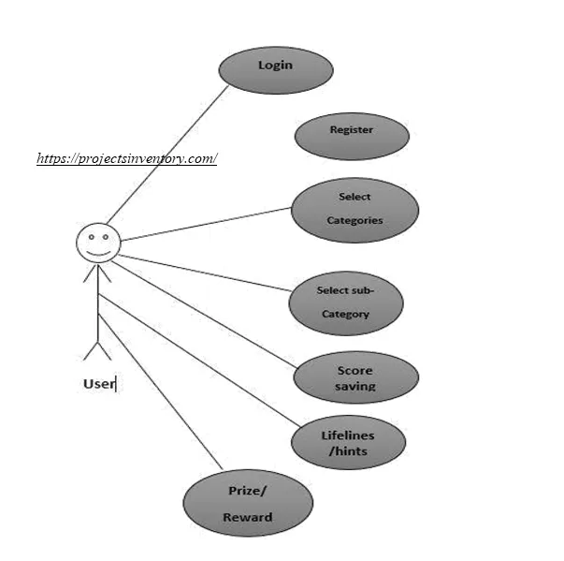
Use case diagram of QUIZ APPLICATION PROJECT

Slide 10
Conclusion
In conclusion, Quiz App presents an exciting opportunity to revolutionize the way we learn and engage with educational content. By combining gamification elements with a wide range of subjects and customizable quizzes, Quiz App makes learning a truly enjoyable experience.
Thank you for your time and attention. Now, it's time to unlock the world of Quiz App and witness the magic of gamified learning.

Slide 11
The End #Peace

